Slide 1

Supporting Families at Risk
Dr. Patricia Lingley-Pottie
President & CEO, Strongest Families Institute
Assistant Professor, Dalhousie University
Scientist, IWK Health Centre
April, 2022

Slide 2

Goals for Today
Learn about Strongest Families Institute (SFI)
Overview of Programs and Outcomes
SFI – IRIS as a digital solution that is scalable
Impacts on at-risk and neurodiverse kids
Case Examples
SFI’s Ongoing Innovation
Conclusion

Slide 3

Children and Youth Mental Health in Canada
10% to 20% of Canadian Children and youth may develop a mental disorder
70% onset in Childhood / adolescence
COVID-19 impacts on MH are more evident in marginalized populations and parents with children
Source : Canadian Institute for Health Information, 2017/ MHCC- https://www.mentalhealthcommission.ca/sites/default/files/2021-02/covid_and_suicide_tip_sheet_eng.pdf

Slide 4
Think outside the box!
Find new ways to deliver timely services to families when and where they need it

Slide 5
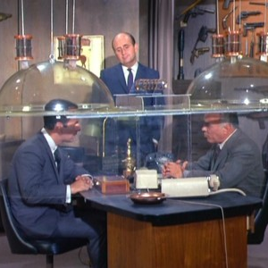



Slide 6

Access Solution: Removing Barriers to Care via eMH
Strongest Families Institute & IRIS e-system
Proven in trials - grounded in 20 years social science research
Co-design is a tenant of SFI
Award-winning Charity, Bilingual
Data-driven – outcome measurement & reporting
Distance Education Model (Bilingual) (Co-designed)
Delivered to families in comfort of home at convenient times
Telephone support coaching (Days/evenings/nights)
Customized, family-centred care (staff competency training)
Quality Assurance monitoring; call recordings graded
Scalable

Slide 7

eHealth Platform - IRIS
Information System
Innovative - Leveraging technology to create solutions
Unique - A dynamic, versatile platform that is scalable
Focused - Dedicated to the success of your project
Client interface; staff interface; report generation system A fully integrated Companion App connection that works even offline: SFI on-the-go!

Slide 8
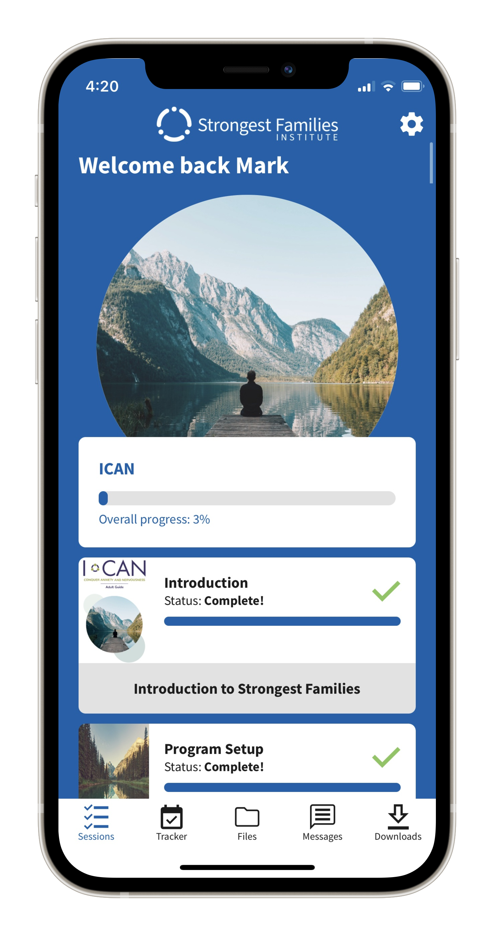

SFI-IRIS Companion App
Enables existing SFI clients to take their programs “on the go”
No internet needed for it to function
Bridges the digital divide, especially for remote regions
Works for all SFI programs

Slide 9



Evidence-based E-services
Programs
Mode of Delivery
3–12
years
Behavior
Parents Empowering Kids (PEK)
Positive Parenting/Self-care
IRIS Technology at the core of the operations
6–18+
years
Anxiety
Chase Worries Away/Defeat Anxiety/ICAN
Relaxation skills/Exposure/Self-care
Handbooks/DVDs or Smart website/App
5–12
years
Night-time Bedwetting
Dry Nights Ahead
Urine alarm/reward system
Telephone coaching modes
1:1 with coach
Group-based
Age adjustments made for developmental delay. Family-centric approach: ICAN having life-changing impacts for parents (as well as emerging adults and seniors)

Slide 10
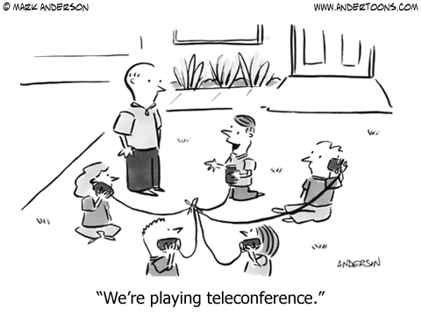
SFI Group-based coaching
1 coach & 10-12 clients
Teleconference bridge
Various locations across Canada
Provides an egaging peer connection, especially during COVID pandemic.
As effective as 1:1 coach approach.
ICAN is part of the Wellness Together Canada Portal!
Coach Career: Work form home! Virtual training and oversight
Source : Canadian Institute for Health Information, 2017/ MHCC- https://www.mentalhealthcommission.ca/sites/default/files/2021-02/covid_and_suicide_tip_sheet_eng.pdf

Slide 11

Coaches
The coach’s role is to:
Reinforce information learned
Problem-solve/role play with parent/child
Encourage and support family
Customize care (Competency training)
Highly capable; highly monitored
Follow SFI protocols; skill-focused
Real-time data entry
Caseload and scorecard reports

Slide 12




Covid-19 Response
Helping Clients Impacted by COVID
Supporting those experiencing impairment in everyday activities due to behavior or anxiety concerns surrounding COVID.
Customizing Programs
Customizing our programs to meet the needs of our clients, regardless of age.
Knowledge Support
Keeping up to date on provincial plans and public health guidelines for addressing COVID (return to work/school)
Skill-Based Adaptions
Adapting the skills to meet clients’ unique needs (school, childcare, work)

Slide 13
Outcomes – Service Delivery (N=13.8k)
Outcome Success
Attrition Rate
High Client Satisfaction
100%
90%
7%
Other strong impacts seen:
Academic progress/attendance
Bullying & Victimization
Family Functioning, Parental Mood
Majority complete
full programs
Overall
Service
Satisfaction

Slide 14



Outcomes – Service Delivery (N=13.8k)
27% of the families
Below 30k income
66% single parents
Anxiety & Depression
38% presented with significant depression
87% resolved both anxiety and depression
55% resolved sleep issues
Strong outcomes
Developmental disorders
Canadian Indigenous
LGBTQ2S+
Community Services / At risk

Slide 15
Behavior: 13 yr old, DX ADHD & Dyslexia (Ont)
Presenting Issues
Inattention (difficulty focusing, completing tasks and following directions); Impulsivity (acts without thinking, fidgets); Non-Compliance (cranky, talks back/defiant, blames, annoyed by others, argues), Temper Tantrums; Aggression (towards family and peers. 5yo sister has had to go to ER a couple times).
Outcome: Strong Impacts- Inattention/Impulsivity; Non-Compliance; Conduct; Child Mood; Family/Child Functioning
Family has had no trips to the ER, plays gently with others. Child requires less prompts to complete tasks and is showing initiative to help out, is more respectful and able to verbalize frustrations than lashing out physically.

Slide 16
“
Being a parent and not feeling adequate as a mom, was so hard for me. I felt low and vulnerable and like a wasn’t going to succeed each week.
I was reminded of my success each week by my coach and of where I had started and how far I have come. My relationship with my daughter was growing and mending… I never once felt like I was ‘messing up’ because my coach was so amazing to point out all the things I was doing right.
[my coach] put so much love and caring into our calls. I am just so incredibly thankful, and I write this with happy tears streaming down my face; thankful for this program and forever grateful to my wonderful coach”

Slide 17
Anxiety: 15 year old, bi-gendered (Atl)
Presenting Issues
Performance (making mistakes/failing at school), Generalized, School absenteeism (20 days previous year due to migraines and panic attacks), Inattention (difficulty focusing, completing tasks, and following directions).
Outcome: Strong Impacts- Generalized Anxiety; Peer Relations; School performance; Global Functioning
Gained confidence, increased participation in classroom/socializing; positive about the future; attends school daily; panic attacks controlled with skills; improved focus. Youth is trying to mend the relationship with mother and father.

Slide 18
“
I am more confident in myself and more happy. I am positive in general; before, I was pretty negative… that’s a major success! I can talk out in class and approach people…just speaking open-mindedly”
- Youth Quote

Slide 19
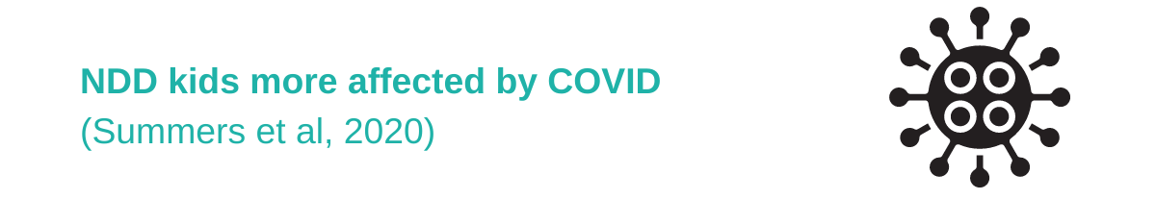
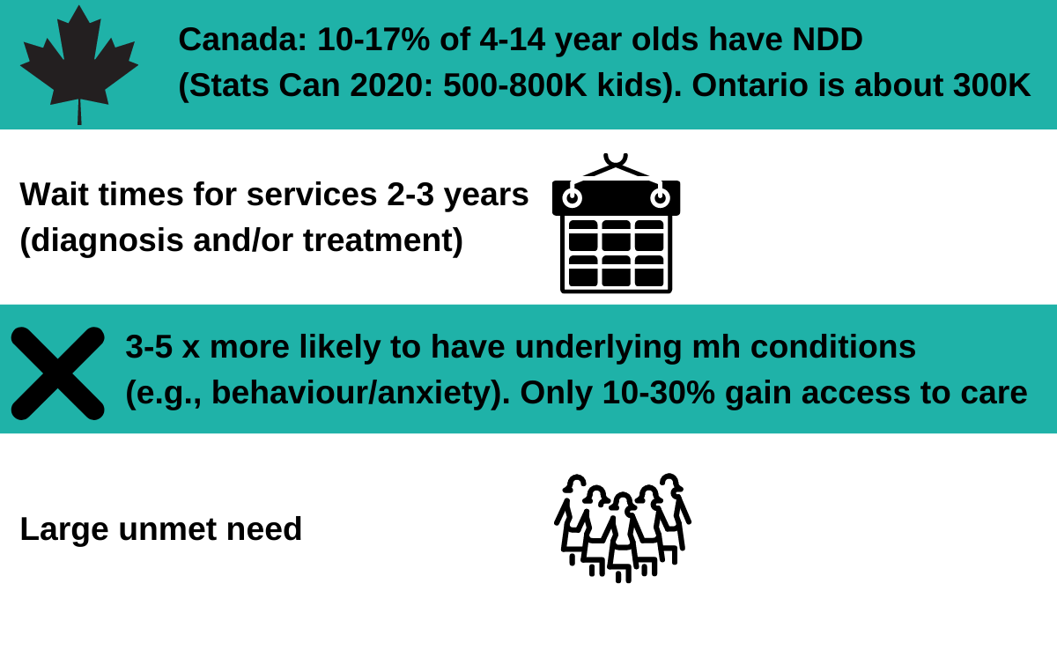
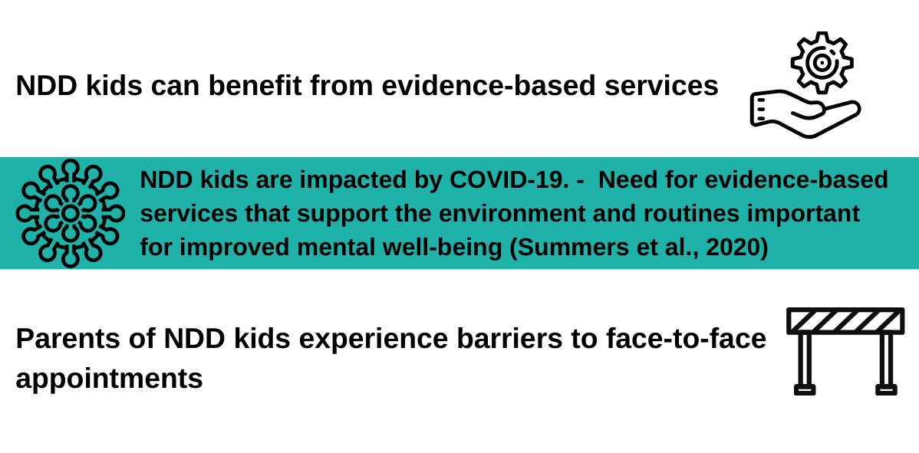
What do we know about Neurodiverse Kids
Source : Dekker, M. C., Koot, H. M., van der Ende, J., & Verhulst, F. C. (2002). Emotional and behavioral problems in children and adolescents with and without intellectual disability. Journal of Child Psychology and Psychiatry, 43(8), 1087-1098. doi:10.1111/1469-7610.00235. Toms, G., Totsika, V., Hastings, R., & Healy, H. (2015). Access to services by children with intellectual disability and mental health problems: Population-based evidence from the UK. Journal of Intellectual and Developmental Disability, 40(3), 239-247. doi:10.3109/13668250.2015.1045460. Holtz, C. A., Carrasco, J. M., Mattek, R. J., & Fox, R. A. (2009). Comparison of treatment outcomes. Child & Family Behavior Therapy, 31(4), 292-311. doi:10.1080/07317100903311018. JAACAP Sep 2020 paper Summers et al: NDD and COVID https://www.jaacap.org/article/S0890-8567(20)31904-3/fulltext; Infographic: https://kidsbrainhealth.ca/index.php/about/overview/ Number of Children: https://www150.statcan.gc.ca/t1/tbl1/en/tv.action?pid=1710000501 https://braininstitute.ca/research-data-sharing/neurodevelopmental-disorders;

Slide 20
SFI NDD Stats: Customized services
Note: Suspected and diagnosed cases are represented. ADHD cases are excluded.
Statistic | All SFI NDD Cases (N=517)
Outcome Success | 88%
Overall Satisfaction | 100%
Attrition | 5%
Annual Income < $30k | 28%
Pref for Online vs Hard copy | 42% vs 58%
Behaviour vs Anxiety | 70% vs 30%
ASD | 56%
2 year + delay | 24%
Tourette’s | 14%
FASD | 6%

Slide 21
Defeat Anxiety: 16 yo Male, Dx ASD (Ont)
Presenting Issues
Separation anxiety; Performance anxiety; Specific fear (COVID-19), Generalized anxiety (past behavior, the future, dying from COVID, the world ending); Social anxiety (doing less with other kids, fear of going outside)
Outcome: Strong impacts on- Generalized & Separation Anxiety; Family & Child Functioning; Socialization
Now able to go on sleepovers at his aunt's house without worry. Less anxious about homework/going to school (more confident in asking questions).He can calm himself down when thinking about COVID. Less anxious in general because of changing his thoughts. Sleeping better.

Slide 22
“
The most helpful part of the program was the skills my son acquired to deal with his anxiety. He was able to self-regulate a lot quicker and be in control. The whole program is fantastic”
- Parent quote

Slide 23
Alberta: 10 yo, Behaviour Program, Dx FASD, previous foster care
Presenting Issues
Inattention (difficulty focusing/completing tasks/following directions); Impulsive; Non-Compliance (cranky, talks back/defiant, blames, annoyed by others, argues); Temper Tantrums; Aggression; Destruction.
Outcome: Strong impacts- Inattention/Impulsivity; Non-Compliance; Conduct; Separation/Generalized Anxiety; Child Mood; Family/Child Functioning; Social Participation; Parental Mood
Now plays nicely with sister. Helps out more by getting her dressed; doing very well completing tasks (dishwasher/ homework). Listens well now. Follows routines without arguing (bedtime/shovel driveway/clean house). Able to emotionally regulate- remove himself from difficult situations at home and daycare instead of reacting negatively.

Slide 24
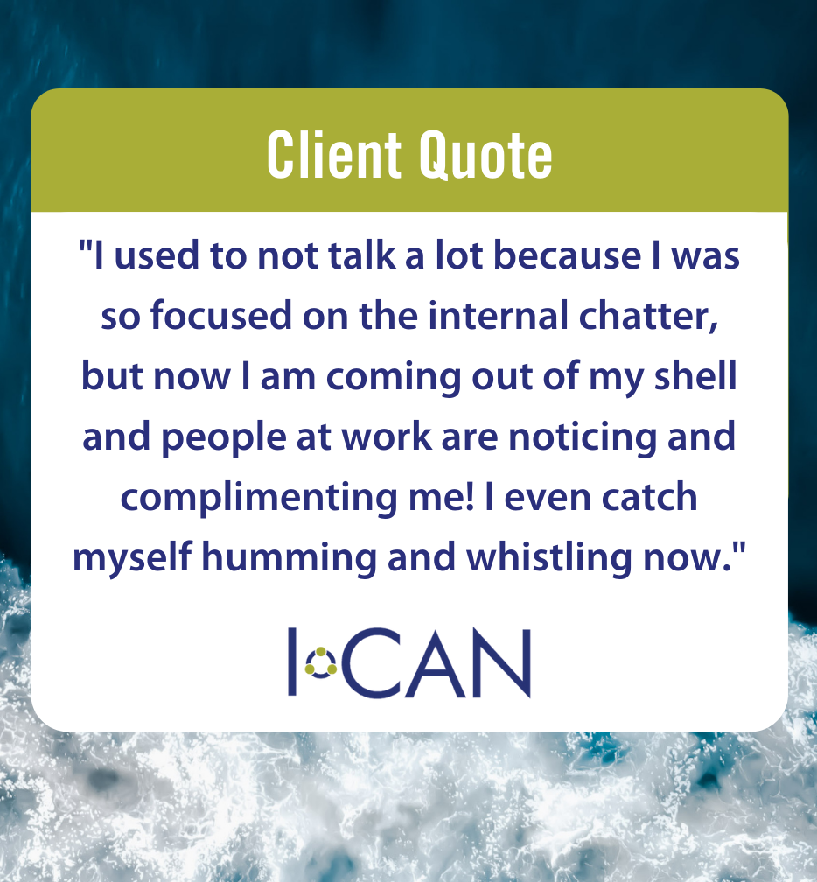


Outcomes (18+)
Significant reduction in Depression, Anxiety & Stress
Life-changing impairment improvements
Approx. 50% reduction in self-medication
63% improved sleep hygiene
64% decreased screen time
ICAN Free, unlimited SFI Coaching access Via Wellness Together Canada Portal. See strongestfamilies.com for areas where ICAN full coaching services are free

Slide 25

SFI Stepped Care Model: Program adaptation
Universal Parenting Program (UPP)
‘Parents Empowering Kids – The early Years (PEK-EY)’
Ready for broad dissemination
Goal to provide universal promotion of positive parenting. Intervening early to prevent behavioural disorders.
In partnership with the NL Government and funding support from the Public Health Agency of Canada (PHAC)
An extension to our current PEK program with varying levels of intensity, aligning with NL stepped care model.
Co-design
Next Phase:
Anxiety program
Expand PEK Brief to older cohort with minor adaptations

Slide 26
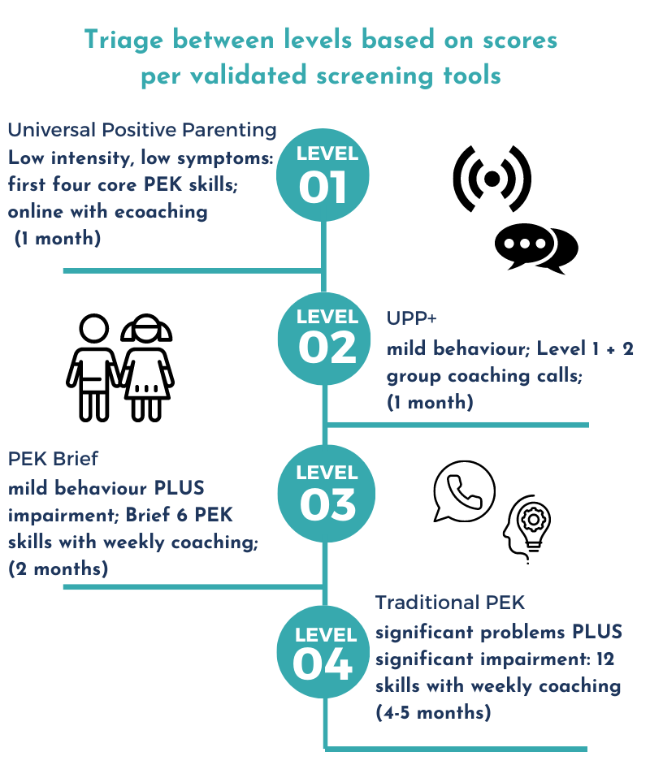
Universal Positive Parenting “UPP” (3-12 yo)
Coming soon: Stepped Care for Anxiety Program

Slide 27



































Our Funders

Slide 28
Where we are located
Provincially/Territorially
All 4 Atlantic Provinces
Manitoba
Northwest Territories
Yukon
Nationally
Military Families Services
Veterans Affairs Canada
Wellness Together Portal (ICAN low intensity only)
Other
Alberta- Calgary/Edmonton Zones, Various Primary Care Networks
Ontario- Various Lead Agencies
Saskatchewan- Northern communities
Quebec- Montreal Island
BC- Penticton

Slide 29

Conclusion
SFI is an effective, Canadian solution Proven eMH family-centric programs
Customized for at-risk & NDD kids/families
Strong outcomes for kids and family
Highly accepted by clients of all ages
Compliments system
Early intervention to promote good MH, prevention through stepped care, and effectively overcomes existing MH conditions for families/those at risk
Scalable to address wait times. Removes Barriers

Slide 30






Questions
To learn more about our services, locations or donating: strongestfamilies.com
Follow us and learn more about self-care – “Self-care Sunday tips”
@StrongestFam
strongestfamilies
Awards

Slide 31
SFI Provides Cost-Effective, Data-driven, Durable Mental Health Solutions
SFI is a not-for-profit (charity) delivering co-designed, evidence-based mental health programs to children, youth, adults, and families across Canada
We bring solutions to the family:
SFI system/programs are grounded in 20 years of social science research. We address mental health needs by supporting adults, children, and youth with mild to moderate mental health conditions.
SFI’s stepped care model incorporates self-mediated and brief interventions as a population mental health promotion/prevention approach.
As our name suggests, we are client/family focused, building strong family relationships and confidence through our life-skills coaching.
Our trained coaches empower families by:
Delivering cognitive-behaviour informed mental health interventions through skill-based information (handbooks or online), skill-demonstration media, and weekly telephone coaching.
Our solutions are cost-effective:
High-quality, timely care prevents serious conditions downstream that significantly harm lives and increase costs to the health care system.
Most of our clients finish the full program in 4-5 months, resolving presenting issues.
We are scalable with a quick ramp-up of services to reduce wait list times. SFI can enable support for more children, youth, and adults in need of services in Alberta.
SFI delivers support at approximately one-third of the cost of traditional service. SFI can offer cost effective service delivery fees for provincial funders based on referral type (e.g., group vs. one on one; adult vs. pediatric).
We are accessible:
We offer bilingual programs designed to support children and youth from 3-17 years of age as well as adults.
We meet families where they are by removing barriers to care by:
Providing distance coaching over the phone and internet at convenient times, in the privacy of home.
Eliminating the need to travel, take time off from work/school, or interrupt normal routines.
Delivering with utmost discretion and privacy and alleviating stigma of receiving mental health services.
Self-referral options available.

Slide 32

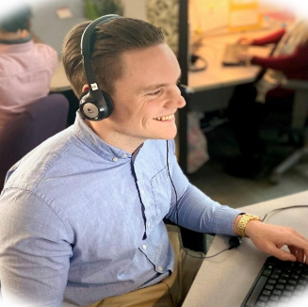

A Canadian Solution and Proven Model of Success
Research
Technology
Skilled Staff
SFI’s distance system of care was developed in a research program and proven in multiple randomized clinical trials at IWK Health Centre, Dalhousie University (Halifax, Nova Scotia).
Dr. Pottie holds scientific appointments (IWK/Dal) and participates in international research efforts as part of SFI’s research strategy.
Member of various eMH collaborative and international eMH organizations.
SFI uses its own proprietary e-health system, IRIS (Intelligent Research and Intervention Software) which enables efficiency and flexibility in the provision of care.
We also have a unique app which provides a robust offline experience.
We have the capacity to ramp up quickly to reduce wait lists:
In 2013, under the Nova Scotia Department of Wellness five-year mental health strategy, SFI acquired approximately 400 children from waiting lists within a 3.5 month period.
SFI leverages internally certified paraprofessional coaches who are highly skilled in working with children, youth, adults, and families. Leveraging trained paraprofessional coaches with Strongest Families’ protocols and clinical oversight creates better value for funders.
Coaches are highly productive. IRIS drives down organizational waste.
The attrition rate for our clients is less than 10 per cent compared to a 40-50 per cent drop-out rate for clinic-based treatment programs.

Slide 33

Thank you!
267 Cobequid Road, Suite 200 Lower Sackville, Nova Scotia Canada B4C 4E6
Toll-free phone: 1-866-470-7111
ppottie@strongestfamilies.com tcunningham@strongestfamilies.com

